Slide 1
Eppstein’s Algorithm
File
Multiple Shortest Paths Graph Algorithm
April 28th
Gavin Crigger, Tao Groves, Matthew Lucio, Justin Park
Notes:
JUSTIN

Slide 2

File
Multiple Shortest Paths Graph Algorithm
April 28th
Problem statement
Given graph G = (V,E), number k, and vertices S and T, find and return the k unique shortest paths between vertices S and E.
S
3
V₂
2
m = |E|, n = |V|
1
5
V₅
V₇
1
V₁
1
V₄
Naive approach: modified Dijkstra's, visiting each vertex at most k times.
Runtime = O(knlog(kn))
2
6
T
5
2
V₃
V₆
4
5
Notes:
JUSTIN - go through full example (note each change in the animations), how djikstra’s can be quickly modified to match this, and a brief motivation (where can this be applied?)
Let’s say that you’re maybe running a shady criminal organization where you might be moving suspicious individuals from one island to another, but you don’t want them to take the same
path since then that’s too obvious for the feds. What’s the most efficient way to have them get to the same location without taking the exact same path?
Let’s say k = 2, our first exploration is a simple dijkstra algorithm, where the path is s —> v1 —> v2 —> v4 —> v5 —>v7 —> t
Then, we explore each of those nodes a second time (yellow), observing the paths from each of those nodes we did not take
The next
K = 2

Slide 3
File
Multiple Shortest Paths Graph Algorithm
April 28th
2
How can we improve this?
Taking me makes your path weight 16 instead of 14!
Find a way to construct a new graph from the input graph such that each edge popped from our min-heap represents the next shortest path - every pop is a path!
Eppstein’s proper constructs this graph in O(m + nlogn) time, and the following k pops run in O(k) time, giving a total runtime of O(m + nlogn + k).
Key concept: sidetrack edges
Given the optimal path from S to E, sidetrack edges represent deviations from the optimal path. They are weighted by how much the total path weight increases from the optimal path by taking that edge.
Notes:
TAO - highlight the fact that we go from popping multiple times to reach the terminal node to popping once and getting a path every pop

Slide 4
File
Multiple Shortest Paths Graph Algorithm
April 28th
Sidetrack graph example
Sidetrack graph G’
Edge weight: sidetrack(u, v, w) = w + d_{v} - d_{u}, where d_{l} represents the weight of the optimal path from vertex l to T.
S
G = (V, E)
T
4
(V₃, S, 4)
V₃
3
2
(V₂, V₃, 3)
5
(S, V₁, 1)
V₂
V₃
3
V₁
3
V₁
(V₁, V₁, 3)
2
(V₂, V₃, 3)
1
S
V₂
All sidetrack edges on the path from a node U to end node T are considered directly connected to U.
Notes:
TAO - walk through example, be sure to explain how the two text boxes apply here (particularly how all edges on the path from U to T are directly connected to U, like V₂, V₃, 3 being connected to S in G’)

Slide 5
File
Multiple Shortest Paths Graph Algorithm
April 28th
Reconstructing paths from single sidetrack edges
P_{v3}
T
4
V₃
The use of implicit path representations is key to Eppstein’s algorithm achieving its quick runtime - each popped sidetrack edge can be used with precalculated values to find the explicit path.
We use Dijkstra's on a reversed G to set up the d_{u} values and optimal paths p_{u} for each vertex. Thus, we can take sidetrack edge (u, v, w) and paths p_{s-u}, p_{v} to construct path p_{s-u} + (u, v, w) to p_{v}.
3
2
5
V₂
3
V₁
3
2
P_{s-v2}
1
S
Notes:
MATTHEW - re-iterate BRIEFLY that indirect representations are the only way to speed up runtime (1 pop 1 path), show how to go back to a full path representation quickly using our precomputed values. Be sure to mention that reverse Djikstra’s is what gives us the optimal path/weight for each vertex (essential for rebuilding path)

Slide 6
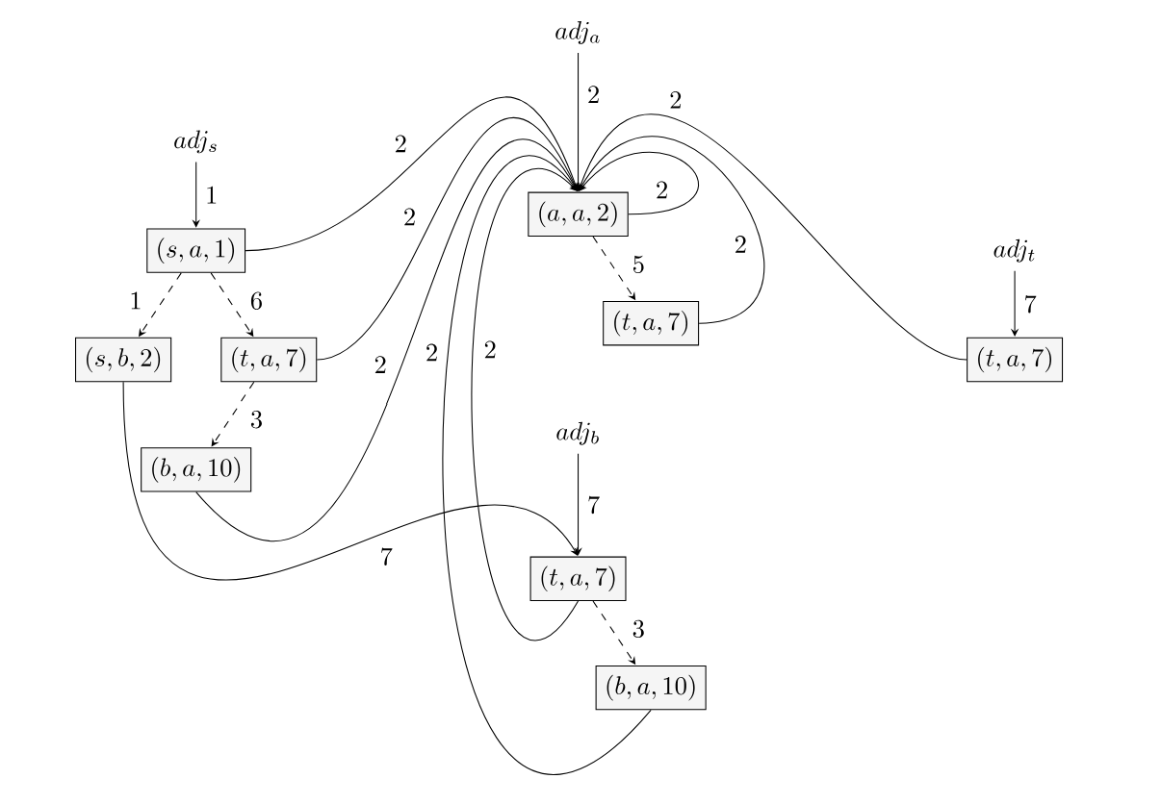
File
Multiple Shortest Paths Graph Algorithm
April 28th
Overall approach
Persistence omitted for simplicity!
1) Construct a graph that stores sidetrack edges as nodes and edge traversals as paths with sidetrack weights as path weights.
Built around using persistent heaps for each adjacency list adj_{u} in our graph, with path traversals connecting heaps.
2) Push the start node and its optimal path weight to a heap, then loop k times: popping from the heap, recording the implicit path representation, and pushing all neighboring sidetrack path weights and their vertices.
Notes:
GAVIN - summarize previous mentioned high-level concepts and how they connect to overall approach. First, use reverse djikstra’s and graph construction as a “precursor/setup” step that allows for quick popping. Then, go over start to and actual loop, mentioning how implicit paths come in and pointing out persistence as a tool for speed up (omitted for time/simplicity)

Slide 7
File
Multiple Shortest Paths Graph Algorithm
April 28th
Pseudocode walkthrough
G, s, t, k
T_{sp}
G
s, t
Eppstein’s algorithm (G = (V, E), s, t, k)
# graph construction
1 build reverse graph G_{r} from G
2 run Dijkstra's on G_{r}, s, t to find d_{u}, p_{u} for all vertices
3 construct shortest path tree T_{sp} from p_{u}
4 create min-heap H_{u} of sidetrack edges for all vertices
5 create result set R_{a} = d_{s}
6 create overarching min-heap Q_{p} initially with (d_{s}, H_{s})
# k-pop algorithm
7 while len(R_{a}) < k and Q_{p} is not empty
8 pop total cost, node from Q_{p}
9 add cost to R_{a}
10 push node’s outgoing edges to Q_{p}
11 return R_{a}
G_{r}
Djikstra’s
d_{u}, p_{u} ∀ u ⋹ V
return!
cost
R_{a}
d_{u}, p_{u}
outgoing edges
Q_{p}
H_{u}
cost, node
Notes:
GAVIN - be sure to click through slide animations as you explain, highlight the split in the algorithm between setup and k-pop, LEAVE TIME FOR RUNTIME PLZ

Slide 8
File
Multiple Shortest Paths Graph Algorithm
April 28th
Runtime analysis
O(m + nlog(n) + k)
1: Graph reversal / Dijkstra’s
2: G’ construction
3: k-pop algorithm
O(m + nlog(n))
Follows a well-documented, optimized Djikstra’s algorithm
O(m + nlog(n))
With persistent heaps, all edges are visited once and all vertices have logarithmic inserts
O(k)
We loop through a constant time heap algorithm (with persistence techniques) until we reach k total paths accumulated
Notes:
MATTHEW - pretty much read from the slides - all of these boil down to the overall runtime. Review slide 7 to be prepared for any extra pieces you might need to explain

Slide 9


File
Multiple Shortest Paths Graph Algorithm
April 28th
Thank you!

